Slide 1
An Introduction to Reading Plus
For parents and guardians

Slide 2
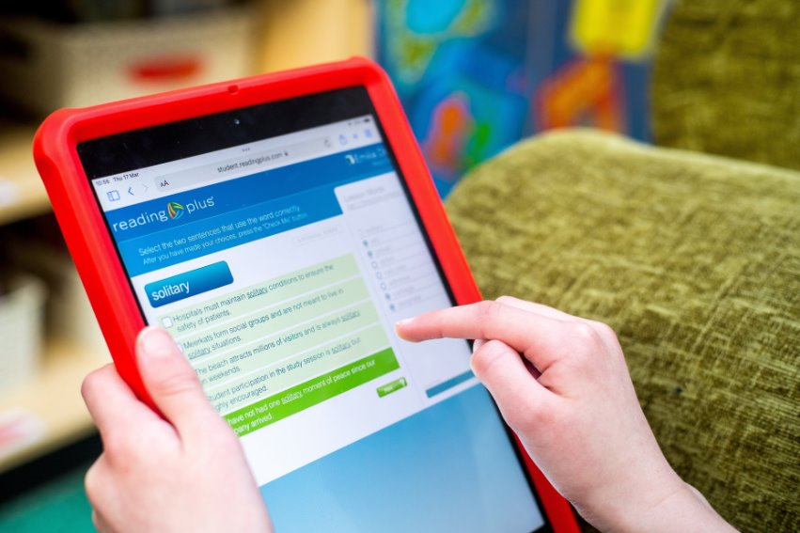
What is Reading Plus? ​
Reading Plus is an online reading development programme designed to improve children’s reading.
With Reading Plus, your child will:
Learn new words to widen their vocabulary.
Better understand what they are reading (improving their comprehension).
Read more quickly.

Slide 3
How does Reading Plus work?
Children sit an assessment when they first log in to the programme. The results place each child at the level that is just right for them.
Children can choose which texts they want to read. There are over 1,200 engaging fiction, non-fiction, and informational texts on Reading Plus.
Reading Plus gives each child a selection of stories to choose from. It tracks their reading habits and recommends texts to broaden their horizons.
Children should complete five reading tasks each week and will answer ten questions after each task to develop their comprehension skills. They also complete one vocabulary task weekly to expand their word knowledge.
Adaptive technology ensures each child is working at their just-right level and is suitably challenged to help them progress.

Slide 4
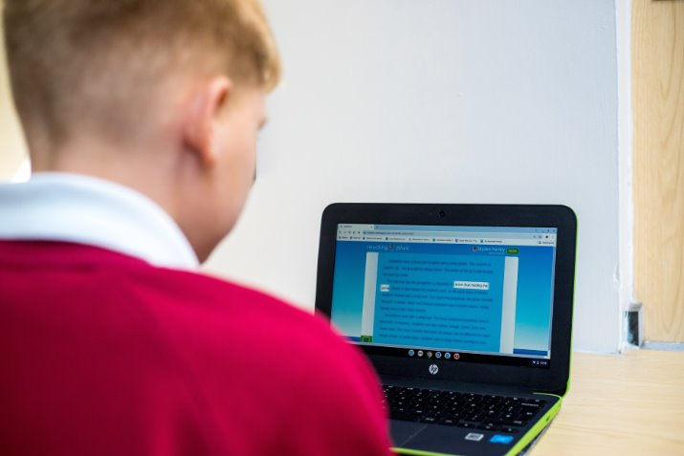
The Guided Window
Your child may see the Guided Window when they select a text to read. This tool guides the readers eyes across a page of text utilising a moving box.
It teaches children to read effectively, which improves reading speed and stamina (how long they can spend reading before getting tired).

Slide 5
The Guided Window
The Guided Window blocks out other lines of text on the page so children can focus on the line they are reading.
This stops children’s eyes from getting distracted, jumping ahead, or falling behind.
The speed of the box is set to each child’s needs. Children may have the option to increase the speed of the window when they score above 80% in the end-of-story tests.
A video of the Guided Window in action.

Slide 6
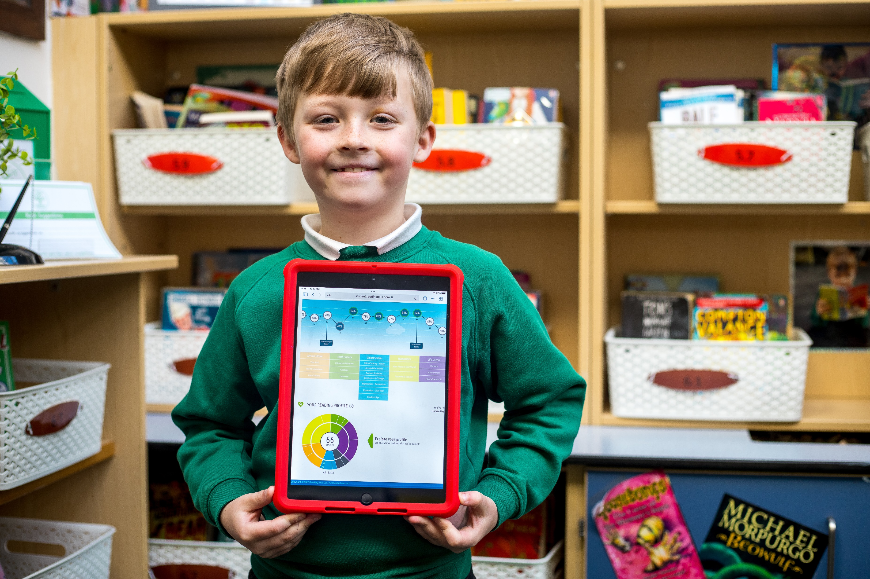
How to support your child
Ask your child about their Reading Plus progress:
“Have you read any interesting stories on Reading Plus this week?”
“What was so great about them?”
“Did you learn any new words this week?”
“How would you use these in a sentence?”
“How many words have you read?”

Slide 7
Encouraging your child to progress
Celebrate your child’s success!
Praise your child for the time and effort they put into improving their reading with Reading Plus.
Congratulate your child on every reading lesson completed with 80% or higher comprehension.
Look for when your child earns combos. Combos help your child to move up a reading level, so celebrate them.

Slide 8
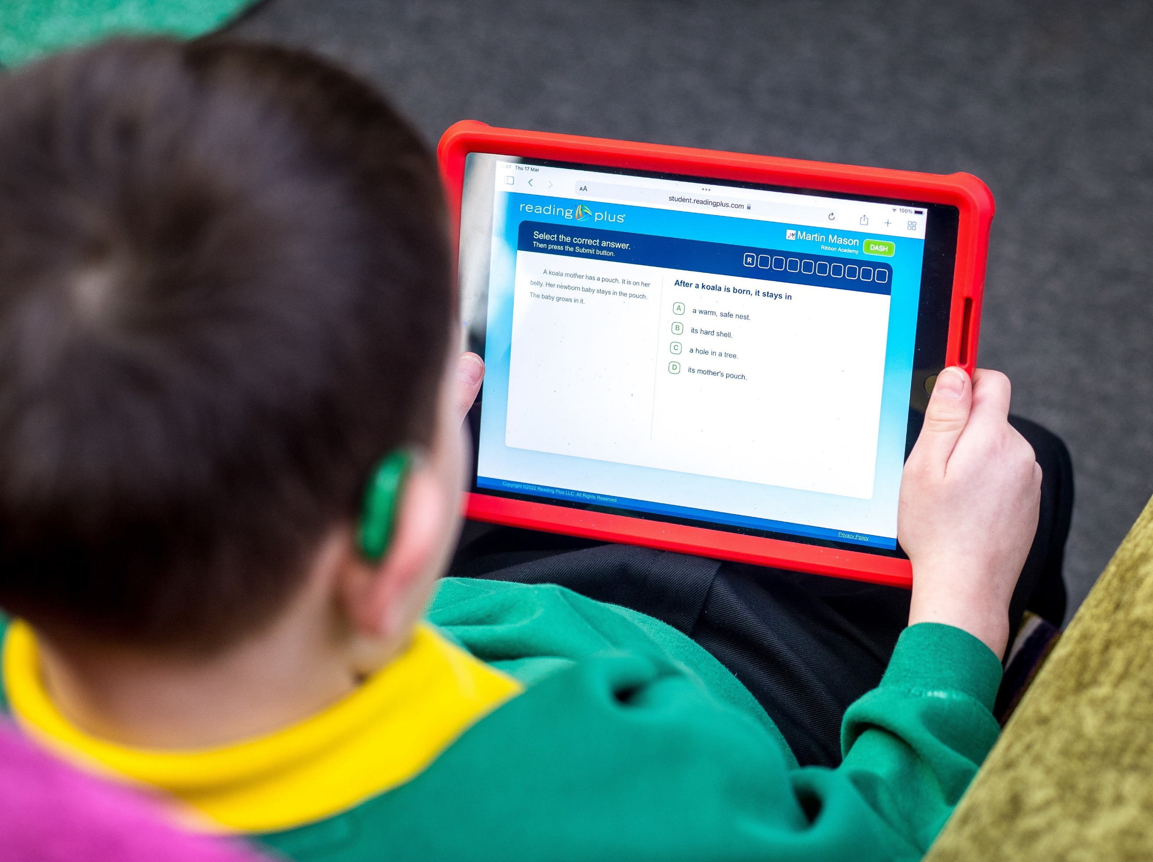
Using Reading Plus at home
Your child can access Reading Plus at home via a computer, laptop, or tablet.
If you have these devices at home, please encourage your child to use Reading Plus for thirty minutes three days a week.
Your child’s school will determine if Reading Plus will also be used for homework.

Slide 9
How to login at home
Ask your child to login as normal via the website: https://student.readingplus.com/
You will have received a letter with login information from the school detailing:
Your school’s unique site code.
Your child’s username and password.
Please contact your child’s teacher if you are unsure of any of these.

Slide 10
How to check your child’s progress
Ask your child to show their Dashboard. From this screen, you will see:
When they have been on Reading Plus.
How long they’ve been on Reading Plus.
The level they are reading at.
Their reading speed.

Slide 11
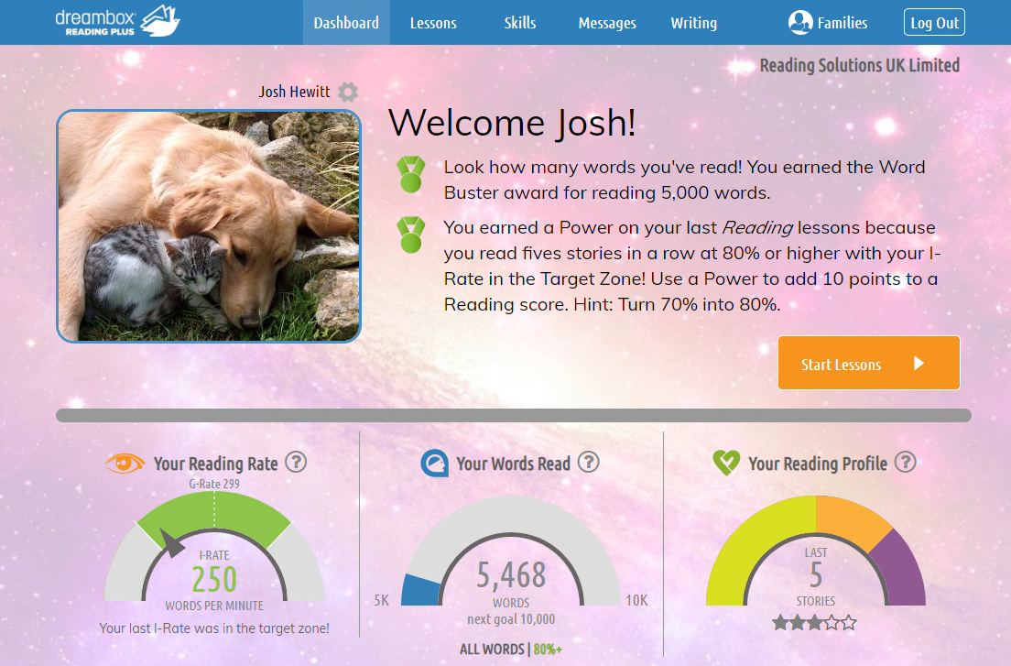
Additional information for parents
If your child uses Reading Plus at home, from their pupil Dashboard, click on the Families link at the top of the screen for more information on how to best support your child with their Reading Plus journey.
You can also find further information by visiting Reading Solutions UK’s Resources Hub.
https://www.daisyeducationuk.com/customer-support/resources-hub/dreambox-reading-plus

Slide 12
Questions?

Slide 13
For more information, please contact your child’s class teacher.
To discover more about Reading Plus
and how it works, please visit: daisyeducationuk.com

